Slide 1


ResQ-Notify

Slide 2
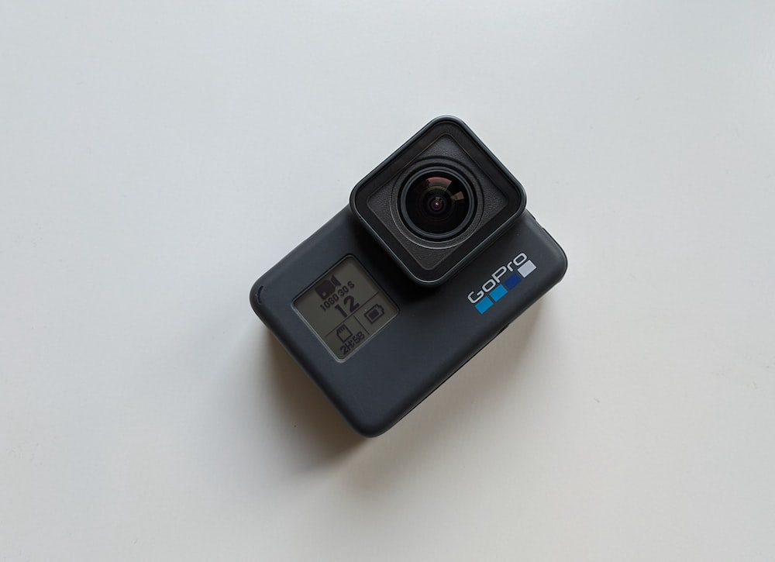

Go-pro
Dashcam

Slide 3
Problem Statement and Some statistics
Current road accident reporting and response systems are slow and inefficient, resulting in preventable suffering and loss of lives. Utilizing AI-powered smart cameras, such as dash cams and Go Pros in vehicles, could swiftly detect accidents, enabling faster response and mitigating accident severity.
Golden Hour: 19% lives can’t be saved
Death Rate: 17 deaths every hour

Slide 4
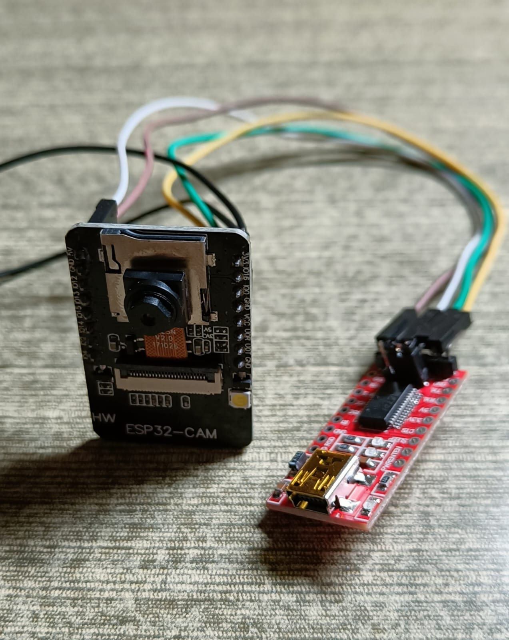
Now let’s SEE what the solution is ?
Esp32-CAM

Slide 5
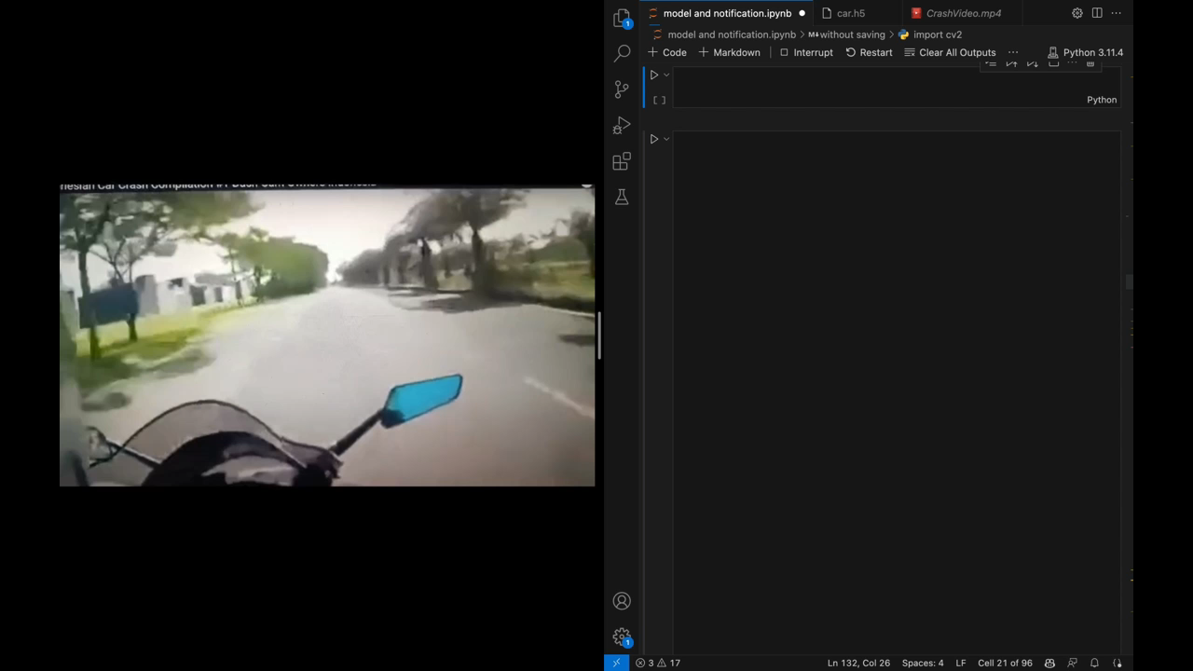
HOW?

Slide 6
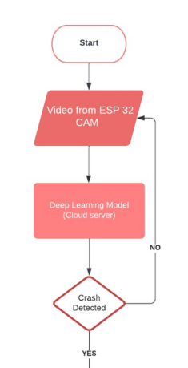
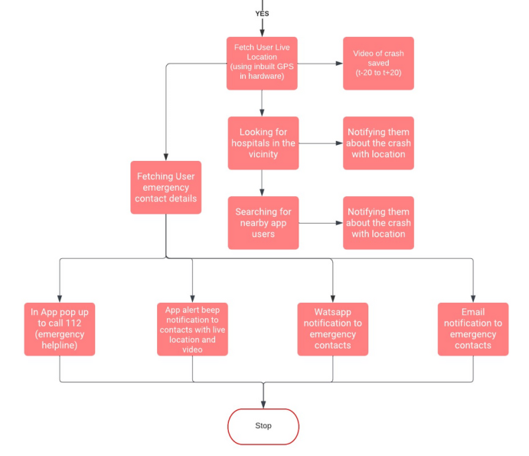
What’s happening here?

Slide 7
ResQ-Notify
WE are open for questions
AIProStack Solutions

